Slide 1
Customer Churn Prediction & Analysis
Project Goals
Content:
Create an entire ETL process in a database and a Power BI dashboard to utilize customer data and achieve the following goals:
Customer Data and achieve below goals:
Visualize & Analyse Customer Data at below levels
Demographic
Geographic
Payment & Account Info
Services
Study Churner Profile & Identify Areas for Implementing Marketing Campaigns
Identify a Method to Predict Future Churners

Slide 2
Metrics Required:
Total Customers
Total Churn & Churn Rate
New Joiners
STEP 1 – ETL Process in MYSQL
STEP 2 - Power BI Transform
STEP 3 – Power BI Measure
STEP 4 – Power BI Visualization
STEP 5 – Predict Customer Churn Using Machine Learning
STEP 6 – Power BI Visualization of Predicted Data

Slide 3
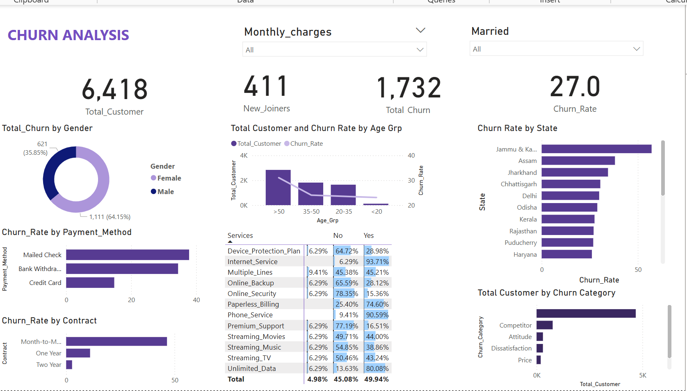
DASHBOARD

Slide 4
Key Insights & Business Implications
Total Customers: 6,418
New Joiners: 411
Total Churned Customers: 1,732
Overall Churate: 27.0%
This is a significant churn rate, indicating a need for focused retention strategies.
Churn by Gender
Female: 64.15% of churned customers
Male: 35.85% of churned customers
Churn is higher among Female customers, suggesting a need to investigate male-targeted service issues.

Slide 5
Churn by Age Group
> 50 years: Highest churn rate at 31.0%
35–50 years: 24.0%
20–35 years: 23.5%
< 20 years: Lowest churn
Older customers are more likely to churn — retention efforts should target this segment.
Churn by Churn Category
Top Reasons:
Competition: 761
Attitude: 301
Dissatisfaction: 300
Price: 196
Competitive pressure and dissatisfaction are major drivers. Need for improved customer experience and loyalty programs.

Slide 6
Churn by Services Used
Higher churn if services not used:
Internet Service: Only 6.3% churn if used vs 93.7% if not used
Phone Service: 9.4% if used
Online Security: 15.6% if used
Service engagement reduces churn. Promoting bundled services may increase stickiness.
Churn by Geography (Top 5 States)
Jammu: 57.2% (highest churn)
Assam: 38.1%
Jharkhand: 34.5%
Chhattisgarh: 30.5%
Delhi: 29.9%
High churn in certain states suggests regional service or pricing dissatisfaction.

Slide 7
Churn by Internet Type
Fiber Optic: Highest churn (41.1%)
Cable: 25.7%
DSL: 19.4%
No Internet Service: 7.8%
Fiber optic users are churning most — despite premium service perception.
Churn by Payment Method & Contract Type
Mailed Check: 37.8% churn
Bank Withdrawal: 34.4%
Credit Card: 14.8%
Month-to-Month Contracts: 46.5% churn
Customers with less commitment (month-to-month) and manual payment methods churn more.

Slide 8
Key Recommendations
Improve service experience for older customers and long-tenure users specially females.
Focus on high-churn regions like Jammu & Assam.
Push long-term contracts to reduce churn.
Encourage usage of multiple services (especially Internet, Phone, Security).
Review Fiber Optic service quality.
Launch proactive retention campaigns targeting competitive churn reasons.

Slide 9
Churn Prediction on Joiner Dataset
Objective: Predict potential customers likely to churn.
Dataset: Joiner customer data (preprocessed and cleaned).
Model Used: Random Forest Classifier
Prediction Results: 378 out of 412 customers predicted as likely to churn.
Model Insights – Random Forest
Algorithm: Random Forest Classifier (ensemble-based)
Handles: Categorical + numerical data
Advantage: Handles non-linearity and provides feature importance
Evaluation Metrics: Accuracy, Confusion Matrix (show image or stats)

Slide 10
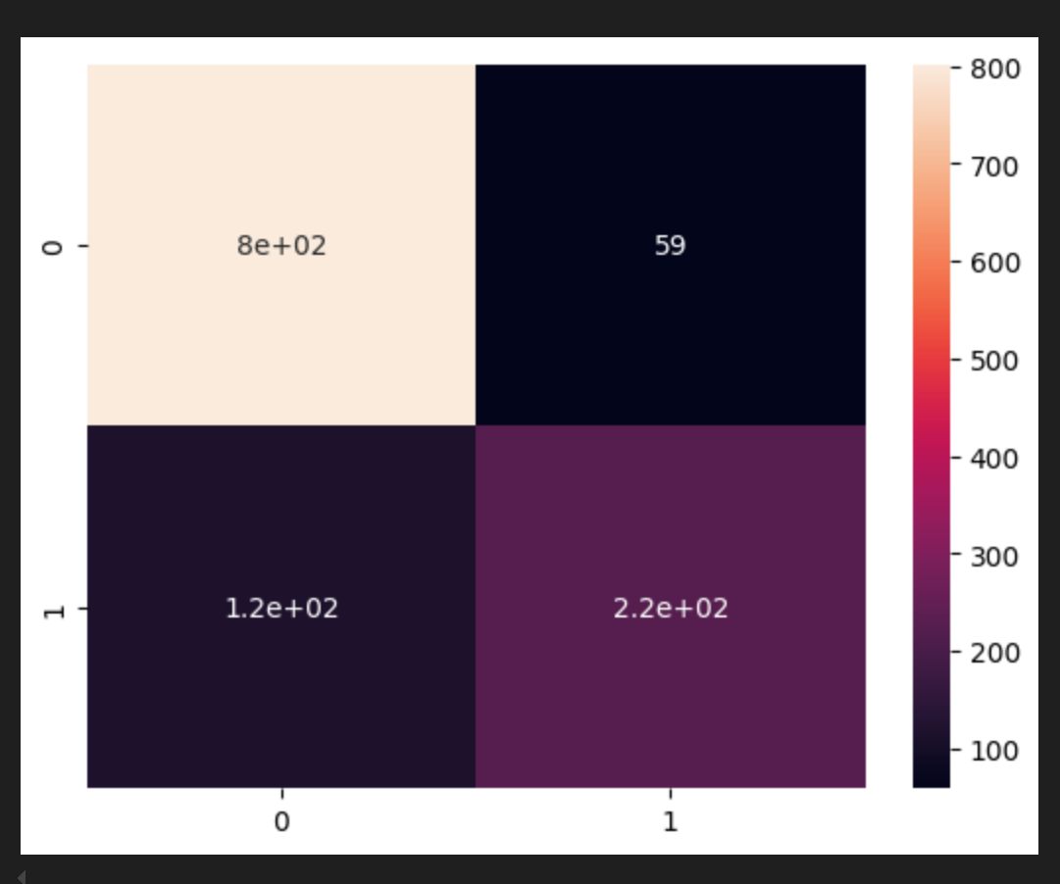

Slide 11
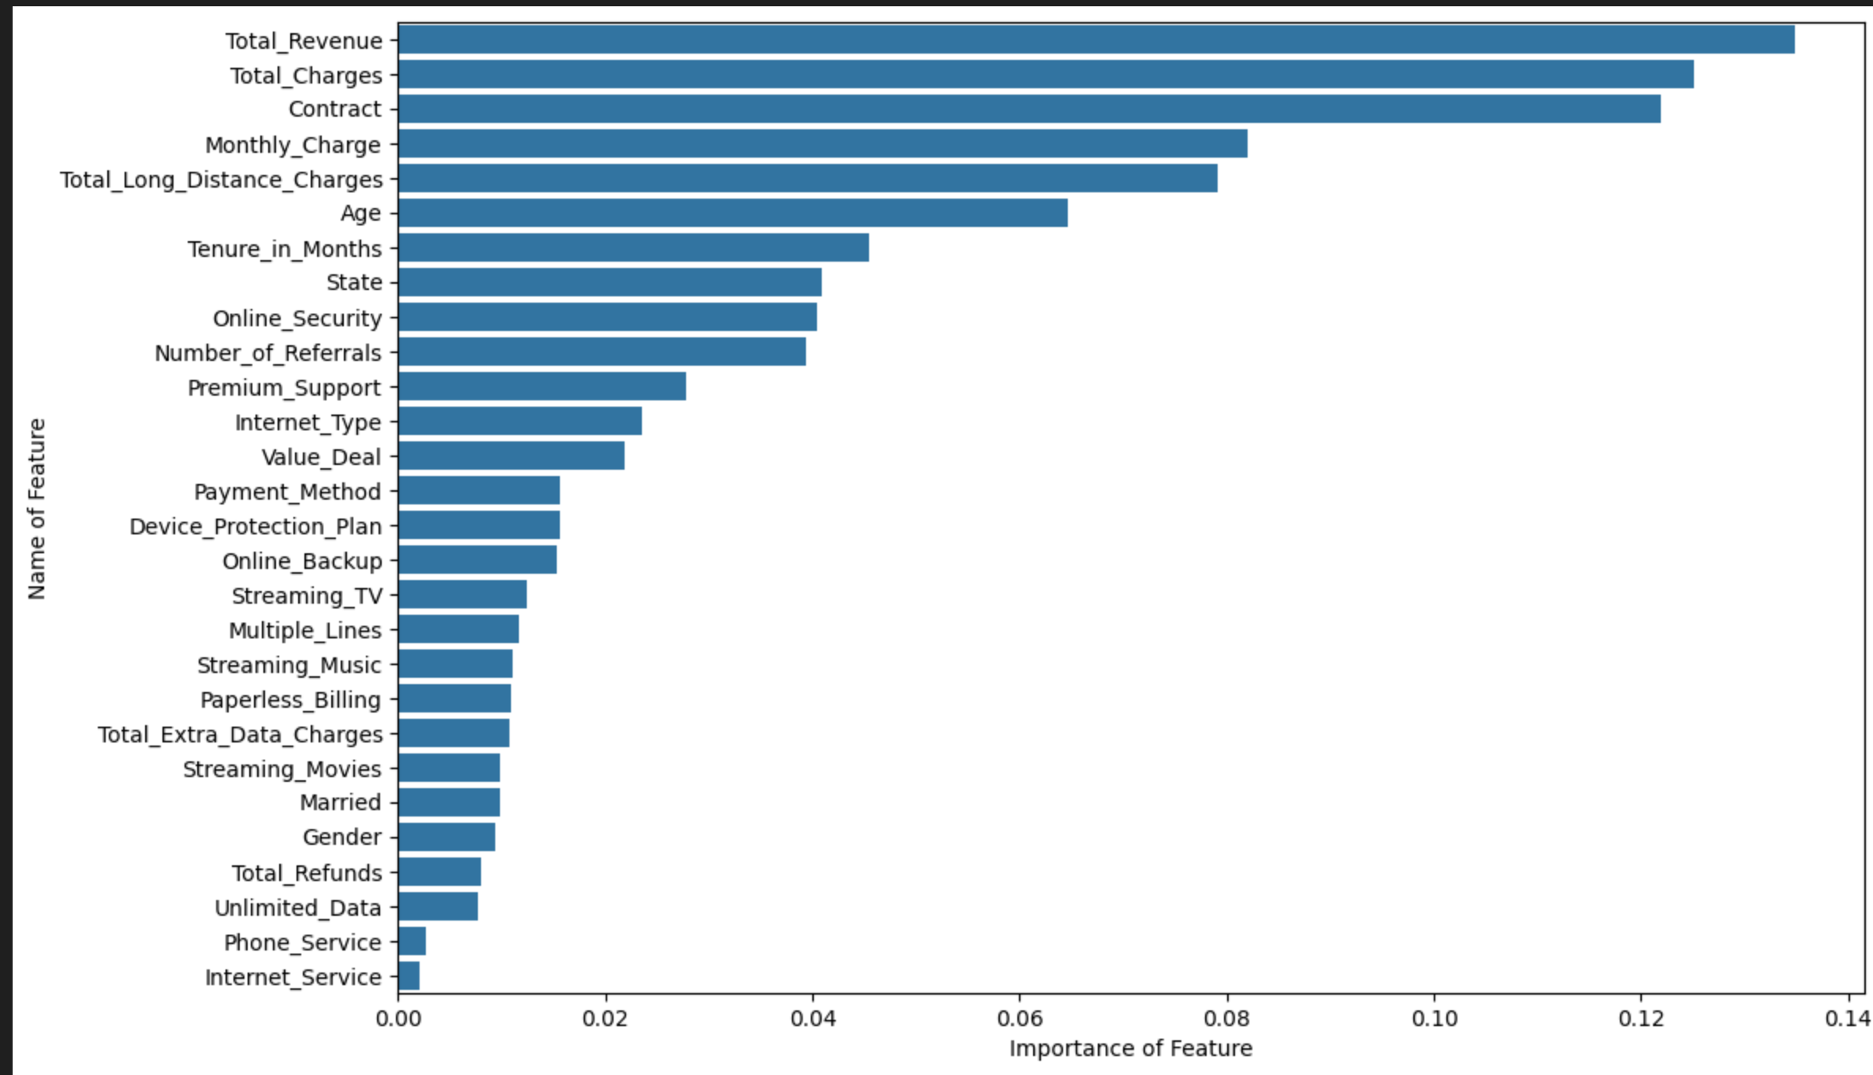
Feature Importance (Feature Selection)
Title: Key Features Driving Churn
Top Predictive Features Identified:

Slide 12
Actionable Insight
A total of 378 high-risk customers identified for proactive retention efforts.
Key drivers of churn include contract type, tenure, and monthly charges.
These findings can help in targeting personalized offers or support
THANK YOU!!

